Slide 1
K-Means & Unsupervised Metrics
Centroid-based clustering, Inertia, Silhouette Score, and Cluster Interpretation

Slide 2
Unsupervised Learning
Types:-
Clustering
Association Rule Mining
Dimensionality Reduction

Slide 3
What is Clustering?
Clustering is a technique for exploring raw unlabeled data and breaking it down into groups or clusters based on similarities or differences.
Organizing data into clusters such that there is high intra cluster similarity there is low inter cluster similarity.
Ex:- Rose, marigold, Neem, Tulsi, mango, Grapes, mint.
(1) Rose, marigold | Neem, Tulsi, mint | Mango,Grapes
(2) Rose, marigold | Neem, Tulsi, mint mango, Grapes
NOTE:- Clustering is subjective.

Slide 4
Types of Clustering Algo
1) Centroid based/ partition based - K means
2) Connectivity based- Hierarchical clustering
3) Sensity based -DBSCAN
4) Graph based - Affinity propagation
5) Compression based - Spectral Clustering, BIRCH

Slide 5
Introduction to K-Means Clustering
• K-Means is an Unsupervised Machine Learning algorithm used for clustering.
• It groups data into K clusters based on feature similarity.
• Each cluster is represented by its centroid (mean position of all points in that cluster).
• The goal is to minimize the distance between points and their cluster’s centroid.

Slide 6
K-Means
K-means is a centroid based clustering algo where we calculate the distance b/w each datapoint and a centroid to assign it to a cluster.
The goal is to identify K-no. of groups (cluster) in the data set.
The name is K-means because it works on mean value and there are K such mean values.

Slide 7
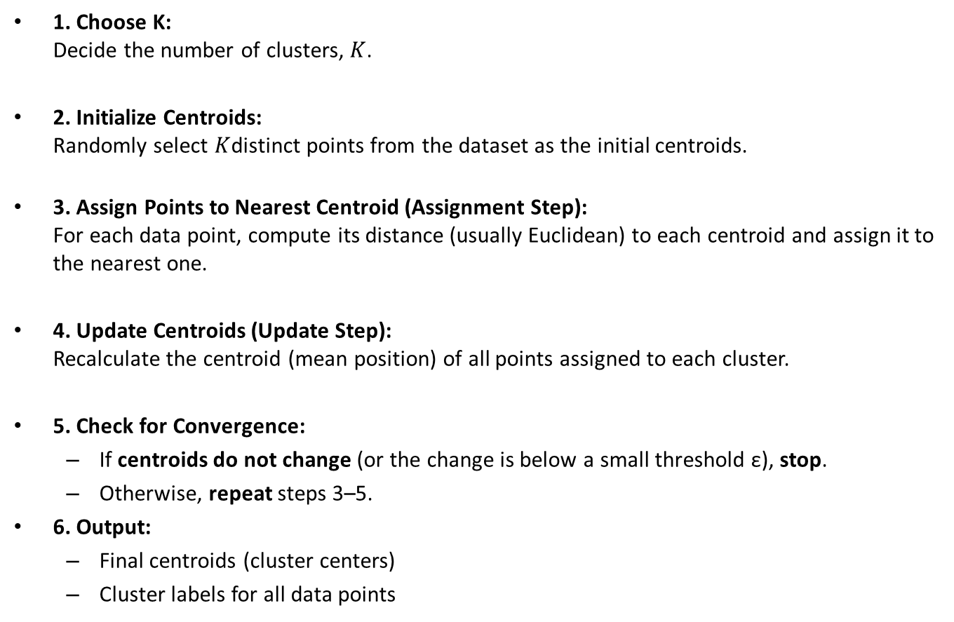
K-Means Algorithm
1. Choose K: Decide the number of clusters, $K$.
2. Initialize Centroids: Randomly select $K$distinct points from the dataset as the initial centroids.
3. Assign Points to Nearest Centroid (Assignment Step): For each data point, compute its distance (usually Euclidean) to each centroid and assign it to the nearest one.
4. Update Centroids (Update Step): Recalculate the centroid (mean position) of all points assigned to each cluster.
5. Check for Convergence:
If centroids do not change (or the change is below a small threshold ε), stop.
Otherwise, repeat steps 3–5.
6. Output:
Final centroids (cluster centers)
Cluster labels for all data points

Slide 8
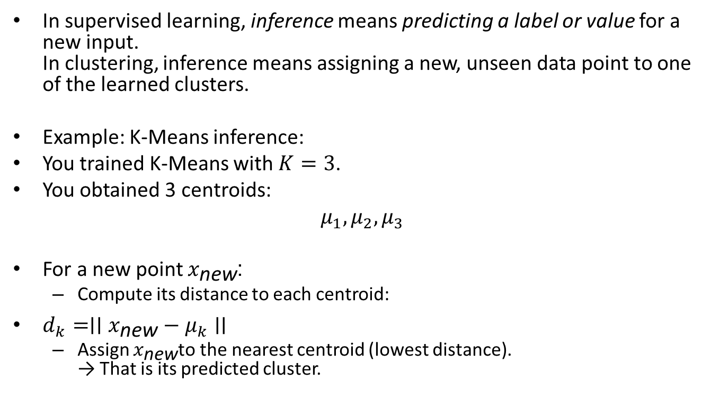
What Inference Means in Clustering
In supervised learning, inference means predicting a label or value for a new input. In clustering, inference means assigning a new, unseen data point to one of the learned clusters.
Example: K-Means inference:
You trained K-Means with $K=3$.
You obtained 3 centroids:
$$μ_{1},μ_{2},μ_{3}$$
For a new point $x_{\text{new}}$:
Compute its distance to each centroid:
$d_{k}=∣∣x_{\text{new}}−μ_{k}∣∣$
Assign $x_{\text{new}}$to the nearest centroid (lowest distance). → That is its predicted cluster.

Slide 9
Advantages of K-Means
Simple and fast to compute.
Works well with large datasets.
Easy to interpret and visualize.

Slide 10
Limitations of K-means algorithm
Where there are outliers
It does not perform well when there is not an appropriate dataset. Struggles with non-spherical clusters or varying densities.
Must specify K in advance.
Sensitive to initial centroid placement.

Slide 11
Example
Consider given 6 2-D data points.
Cluster them into 2 groups using K-means clustering.
Use distance measure as Euclidean distance. Assume P2 and P6 as Initial cluster centers.
The points are
P1 (0, 0), P2 (0, 1), P3 (1, 0), P4(5, 0), P5 (6, 0), and P6 (6, 1).

Slide 12
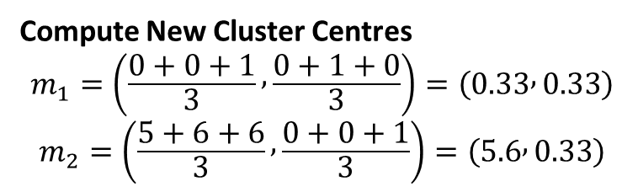
Initial Step: Compute Distance from P₂ and P₆
Points | Distance to P₂ | Distance to P₆ | New Cluster
P₁ | 0 | √37 | P₂
P₂ | 0 | 6 | P₂
P₃ | 1.414 | √26 | P₂
P₄ | √26 | √2 | P₆
P₅ | √37 | 1 | P₆
P₆ | 6 | 0 | P₆
Now Cluster Centre becomes: → Cluster 1 (C₁): P₁, P₂, P₃ → Cluster 2 (C₂): P₄, P₅, P₆
Compute New Cluster Centres
$$m_{1}=\left(\frac{0+0+1}{3} , \frac{0+1+0}{3}\right)=\left(0.33 , 0.33\right)$$
$$m_{2}=\left(\frac{5+6+6}{3} , \frac{0+0+1}{3}\right)=\left(5.6 , 0.33\right)$$

Slide 13
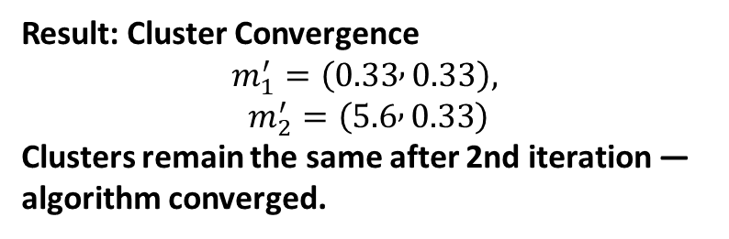
Repeat till where point don’t change upto 2 iterations
Iteration 2: Reassign Points Based on New Centers
Points | Distance to m₁(0.33,0.33) | Distance to m₂(5.6,0.33) | New Cluster
P₁ | 0.46 | 5.68 | m₁
P₂ | 0.746 | 5.699 | m₁
P₃ | 0.746 | 4.6716 | m₁
P₄ | 4.681 | 0.7446 | m₂
P₅ | 5.679 | 0.4738 | m₂
P₆ | 5.71 | 0.7513 | m₂
Result: Cluster Convergence
$$m_{1}^{′}=\left(0.33 , 0.33\right),$$
$$m_{2}^{′}=\left(5.6 , 0.33\right)$$
Clusters remain the same after 2nd iteration — algorithm converged.

Slide 14
Centroid-Based Clustering
• Each cluster has a center point called a centroid.
• Points are assigned to the cluster whose centroid is closest to them.
• The algorithm iteratively moves centroids to minimize within-cluster variance.
Example: In a 2D dataset, centroids represent the 'average location' of all points in each cluster.

Slide 15

Inertia
Inertia measures how tightly the data points are clustered around centroids.
How compact each cluster is (how close points are to their own centroid).
It measures the internal tightness of clusters.
• Lower inertia → better clustering (points are closer to their centroid).
• Used to select the right K using the 'Elbow Method'.

Slide 16

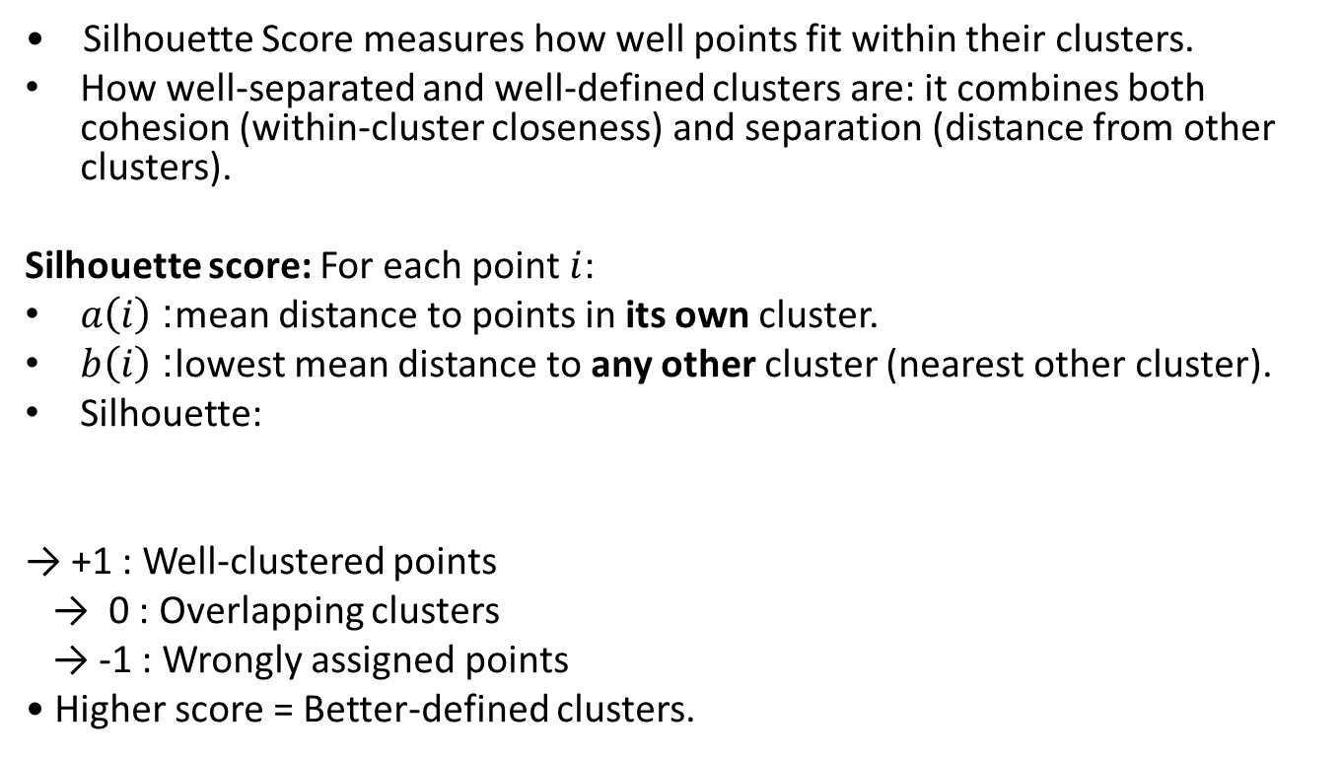
Silhouette Score
• Silhouette Score measures how well points fit within their clusters.
How well-separated and well-defined clusters are: it combines both cohesion (within-cluster closeness) and separation (distance from other clusters).
Silhouette score: For each point $i$:
$a\left(i\right)$: mean distance to points in its own cluster.
$b\left(i\right)$: lowest mean distance to any other cluster (nearest other cluster).
Silhouette:
→ +1 : Well-clustered points
→ 0 : Overlapping clusters
→ -1 : Wrongly assigned points
• Higher score = Better-defined clusters.
s(i)= $\frac{\text{b}\text{(}\text{i}\text{)}\text{−}\text{a}\text{(}\text{i}\text{)}}{\text{max}\text{\{}\text{a}\text{(}\text{i}\text{),}\text{b}\text{(}\text{i}\text{)}\text{\}}}$​ ∈[−1,1]

Slide 17
Interpreting Clusters
• After clustering, analyze what each cluster represents.
• Look for patterns or characteristics shared within each group.
• Visualize clusters in 2D/3D to understand their separation.
• Example: In customer segmentation, clusters may represent spending habits or age groups.

Slide 18
Summary
• K-Means is a centroid-based clustering algorithm that minimizes intra-cluster distance.
• Inertia and Silhouette Score help evaluate cluster quality.
• Interpreting clusters provides real-world insights into data patterns.

